Slide 1
Computational Complexity

Slide 2
Given a problem X, and a machine model M, how long does it take to solve X using a machine from M?
How can we classify problems into complexity classes based on their apparent difficulty?
What relationships can we established between these complexity classes?
Notes:
"错综复杂"到底有多复杂？
《周易·系辞上》：
“参伍以变，错综其数”。
a) Random Access Machines b) Straight Line Programs and Circuits c) Vector Machines d) Turing Machines e) Pointer Machines f) Decision Trees g) Machines That Make Random Choices

Slide 3
☞ Problems and languages
Decision problems: an input x and have to answer “yes” or “no” based on whether x satisfies some predicate P.
An alphabet Σ is a finite set of symbols; {0, 1} for example
A language L over Σ is any set of strings made up of symbols from Σ.
Encoding:
binary representation 19 = 10011
unary representations 19 = 1111111111111111111
Notes:
Decision vs Search
Search, if there exists a solution, then gives that solution.

Slide 4
A language is the formal realization of a problem.
For a problem 𝑋, the corresponding language L is:
If x ∈ L then are supposed to answer “yes” and if
x ∉ L, we are supposed to answer “no.”
An implementation of a language is a machine of some sort that does this correctly, and a complexity class
will just be a set of languages whose implementations have some particular complexity property.
(Turing) Machine: A (Turing) Machine is the formal analogue of an algorithm.
An algorithm has a time complexity
A problem belongs to a complexity class
Notes:
𝐿={𝑤∣w is the encoding of an input 𝑦 to problem 𝑋, and the answer to input 𝑦 for problem 𝑋 is "Yes" }

Slide 5

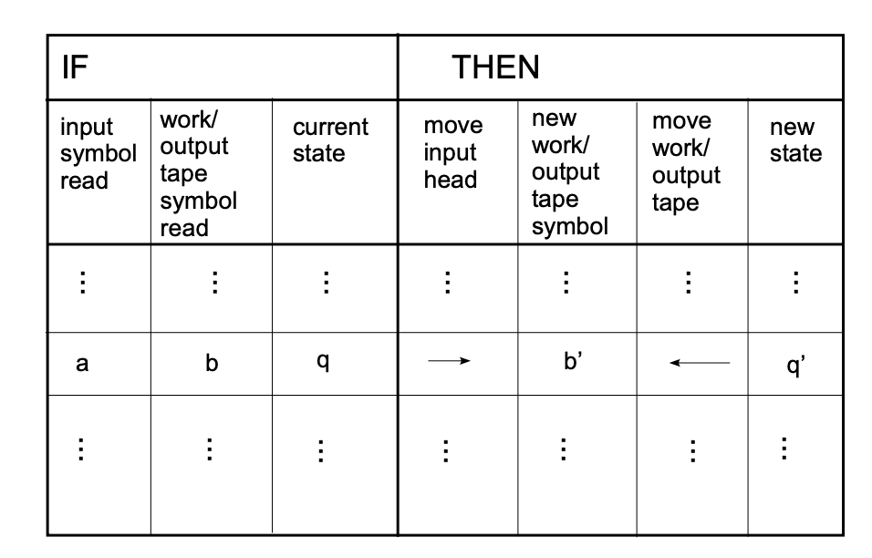
NP-Completeness
Models of computation
☞
TURING MACHINE
The transition function of a two tape TM (i.e., a TM with one input tape and one work/output tape).
Components
Infinite Memory
Scanner
and
Operations
① Change the finite control state.
② Erase the symbol in the unit currently pointed by head, and write a new symbol in.
Scanner
...
Input
③ Head moves one unit to the left (L), or to the right (R), or stays at its current position (S).
... ...
Work
... ... ... ...
...
... ... ... ...
Output

Slide 6
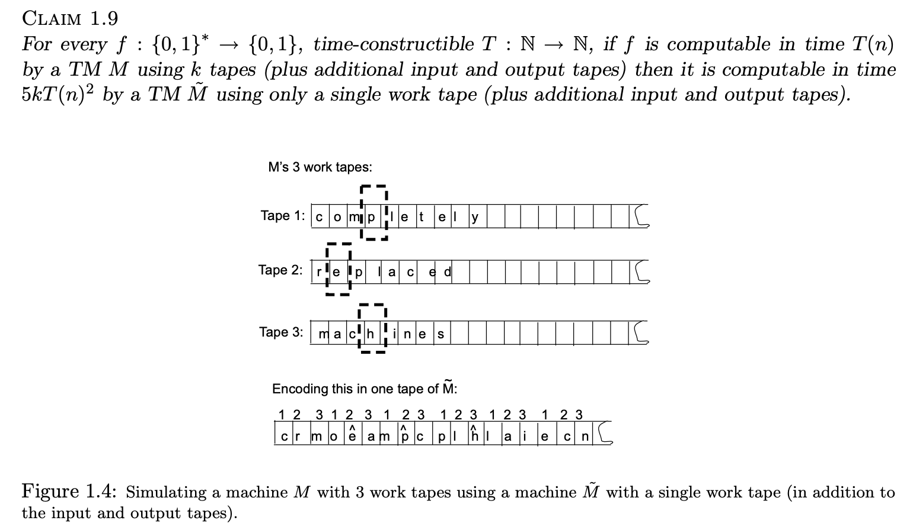
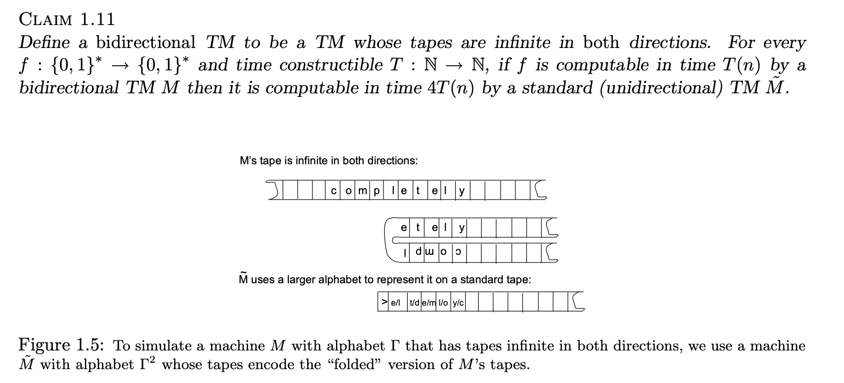
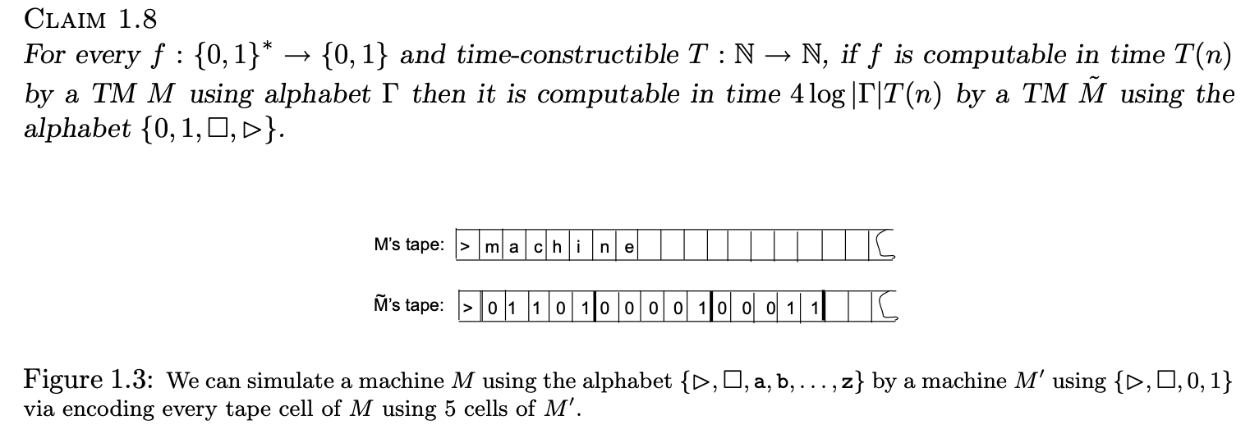
Robustness
Computational complexity: A modern approach
Author(s): Sanjeev Arora, Boaz Barak
Publisher: Cambridge University Press, Year: 2009
Notes:
Computational complexity: A modern approach
Author(s): Sanjeev Arora, Boaz Barak
Publisher: Cambridge University Press, Year: 2009
ISBN: 9780521424264,0521424267

Slide 7
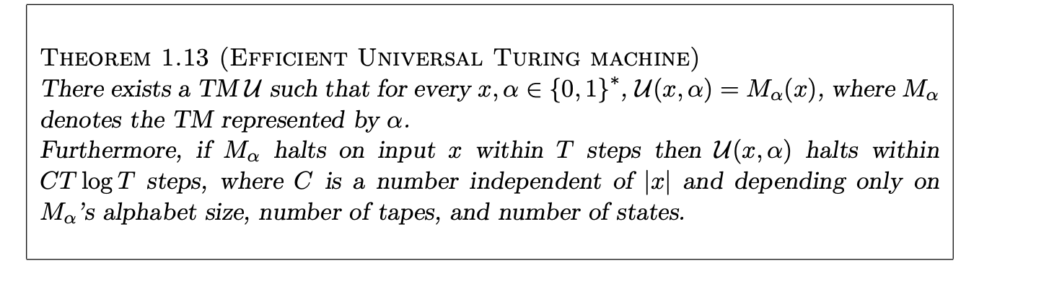
Universal Turing Machine
The extended Church-Turing thesis
Any language that can be decided by a physically realizable computing device M in time T(n) can be decided by a Turing machine in time O(T(n) ^{k} ) for some fixed k that depends only on M.
Notes:
Computational complexity: A modern approach
any ”reasonable” model of computation can be efficiently simulated on a standard model such as a Turing Machine or a Random Access Machine or a cellular automaton

Slide 8
Random Access Machine.
has a controller with registers and a memory
Each register and memory location holds an integer
Do arithmetic on registers, compare registers, and load or store a value from a memory location addressed by a particular register all as a single step (i.e.,1 time step).
Loops and subroutines are not considered simple operations. Instead, they are the composition of many single-step operations.
The running time of an algorithm (time complexity) is based on RAM.
Machine-independent

Slide 9
Nondeterministic Turing machine
A Deterministic Turing Machine executes one instruction at each point in time. Then depending on the instruction, it goes to the next unique instruction.
Historically, the only difference between an NDTM and a standard TM is that an NDTM has two transition functions δ₀ and δ₁, and the NDTM can choose between them.
A Nondeterministic Turing Machine is free to choose its next step from a finite set. And if one of these steps leads to a solution, it will always choose the correct one.
Nondeterminism is now typically represented by giving a machine an extra input, the certificate or witness.
The witness provide the sequence of choices that lead to the accepting branch (if there is one).
Notes:
We give it the magical ability to split into two copies, each with a different bit telling it what to do next. These copies can then split further into exponentially
many copies, or branches. If any of the branches accepts, then we say the
machine as a whole accepts; if none do, the machine rejects.

Slide 10
Examples
COMPOSITES. Given an integer s, is s composite?
Certificate/witness. A nontrivial factor t of s. Note that such a certificate exists iff s is composite. Moreover |t| ≤ |s|.
SAT. Given a CNF formula Φ, is there a satisfying assignment?
Certificate. An assignment of truth values to the n boolean variables.

Slide 11
If we have a Turing machine M that halts in an accepting state on any input x ∈ L and halts in a rejecting state on any input x ∉ L, we say that
M decides L.
A language L is decided by a nondeterministic machine M if, for every x ∈ L , there exists a witness w such that M(x,w) accepts, and for every x ∉ L, there does not exist a witness w such that M(x,w) accepts.

Slide 12

NP-Completeness
Complexity classes
NP: Nondeterministic polynomial-time
The problem is NP if we can prove any solution is true in polynomial time.
〖Example〗Hamilton cycle problem: Find a single cycle that contains every vertex – does this simple circuit include all the vertices?
NP
Note: Not all decidable problems are in NP. For example, consider the problem of determining whether a graph does not have a Hamiltonian cycle.

Slide 13
NP-Completeness
A Formal-language Framework
☞ Abstract Problem
an abstract problem Q is a binary relation on a set I of problem instances and a set S of problem solutions.
〖Example〗For SHORTEST-PATH problem
I = { <G, u, v>: G=(V, E) is an undirected graph; u, v ∈ V };
S = { <u, w₁, w₂, …, w_{k}, v>: <u, w₁>, …, <w_{k}, v> ∈ E }.
For every i ∈I, SHORTEST-PATH(i) = s ∈ S.
For decision problem PATH:
I = { <G, u, v, k>: G=(V, E) is an undirected graph; u, v ∈ V;
k ≥ 0 is an integer };
S = { 0, 1 }.
For every i ∈I, PATH(i) = 1 or 0.
☞ Encodings
Map I into a binary string { 0, 1 }* → Q is a concrete problem.

Slide 14
NP-Completeness
☞ Formal-language Theory
— for decision problem
{ 0, 1 }
An alphabet Σ is a finite set of symbols
A language L over Σ is any set of strings made up of symbols from Σ
Denote empty string by ε
Denote empty language by Ø
Language of all strings over Σ is denoted by Σ*
The complement of L is denoted by Σ*-L
The concatenation of two languages L₁ and L₂ is the language
L = { x₁x₂ : x₁ ∈ L₁ and x₂ ∈ L₂ }.
The closure or Kleene star of a language L is the language
L*= {ε} ∪ L ∪ L² ∪ L³ ∪ ···,
where L^{k} is the language obtained by concatenating L to itself k times
L = { x ∈ Σ*: Q(x) = 1 }

Slide 15
NP-Completeness
Algorithm A accepts a string x ∈ {0, 1}* if A(x) = 1
Algorithm A rejects a string x if A(x) = 0
A language L is decided by an algorithm A if every binary string in L is accepted by A and every binary string not in L is rejected by A
To accept a language, an algorithm need only worry about strings in L, but to decide a language, it must correctly accept or reject every string in {0, 1}*
P = { L ⊆ {0, 1}* : there exists an algorithm A that decides
L in polynomial time }

Slide 16
NP-Completeness
A verification algorithm is a two-argument algorithm A, where one argument is an ordinary input string x and the other is a binary string y called a certificate.
A two-argument algorithm A verifies an input string x if there exists a certificate y such that A(x, y) = 1.
The language verified by a verification algorithm A is L = { x ∈ {0, 1}* : there exists y ∈ {0, 1}* such that A(x, y) = 1}.
〖Example〗 For SAT
Certificate:
A language L belongs to NP iff there exist a two-input polynomial-time algorithm A and a constant c such that L = { x ∈ {0, 1}* : there exists a certificate y with |y| = O(|x|^{c}) such that A(x, y) = 1 }. We say that algorithm A verifies language L in polynomial time.

Slide 17
NP-Completeness
⬧
complexity class co-NP = the set of languages L such that
Four possibilities:
P=NP=co-NP
co-NP
P=NP∩co-NP
NP
NP=co-NP
co-NP
NP∩co-NP
NP
P
P
Notes:
An example of an NP-complete problem is the subset sum problem: given a finite set of integers, is there a non-empty subset that sums to zero? To give a proof of a "yes" instance, one must specify a non-empty subset that does sum to zero, which is easy to verify. The complementary problem asks: "given a finite set of integers, does every non-empty subset have a non-zero sum?". Even if someone claims to know the answer to the complementary question for a given set, we do not know how to verify their solution efficiently. To give a proof of the "yes" instance, they may try to list every single subset and their supposedly non-zero sum. However, verifying their claim is just as inefficient as checking all possible sums in the first place. Because of this dilemma, we do not know if the subset sum problem is in co-NP. Note however that the complementary question itself is in co-NP, since the original question is in NP.

Slide 18
Reductions and NP-complete problems

Slide 19
NP-Completeness

⬧
☞ NP-Complete Problems
-- the hardest
An NP-complete problem has the property that any problem in NP can be polynomially reduced to it.
If we can solve any NP-complete problem in polynomial time, then we will be able to solve, in polynomial time, all the problems in NP!
Problem B is at least as hard as problem A
Problem A is polynomial-time reducible to B, A ≤_{P} B
B is at least as hard as A because if you can solve B, you can solve A
Notes:
Decision problem is easier, since we only have to answer yes or no.
Optimization problem can be related to a decision problem.
Example: SHORTEST-PATH relates to PATH: given a directed graph G, vertices u and v, and an integer k, does a path exist from u to v consisting of at most k edges?

Slide 20
Turing reductions are also called oracle reductions; polynomial-time Turing reductions are also called Cook reductions.
Problem A reduce to problem B
Given any instance α ∈ Problem A, if we can find a program R(α) → β ∈ Problem B with T_{R}(N) = O(N^{k1}), and another program D(β) to get an answer in time O(N^{k2}). And more, if the answer for β is the same as the answer for α. Then
oracle
O(N^{k1})
O(N^{k2})
∀ α ∈ A
β = R(α)
D(β)
answer for β
= answer for α
O(N^{k})
polynomial-time many-one reductions, which are also called Karp reductions
A language L₁ is polynomial-time reducible to a language L₂ ( L₁ ≤_{P} L₂ ) if there exists a polynomial-time computable function f : {0, 1}* → {0,1}* such that for all x {0, 1}*, x ∈ L₁ iff f (x) ∈ L₂.
Notes:
We call the function f the reduction function, and a polynomial-time algorithm F that computes f is called a reduction algorithm.

Slide 21
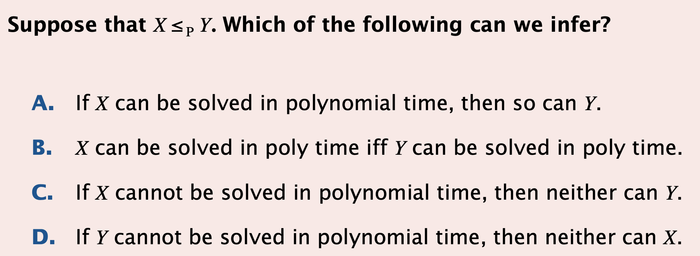
Quiz
Notes:
Answer C.

Slide 22
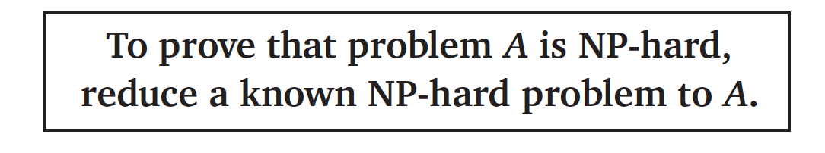
NP-Completeness
A language L ⊆ {0, 1}* is NP-complete if
1. L ∈ NP, and
2. L’ ≤_{P} L for every L’ ∈ NP.
A language L ⊆ {0, 1}* is NP-hard if
1. L’ ≤_{P} L for every L’ ∈ NP.

Slide 23
Lemma. If L₁, L₂ ⊆ {0,1}* are languages such that L₁ ≤_{P} L₂, then L₂ ∈ P implies L₁ ∈ P.
f (x)
x
F
A₂
A₁

Slide 24
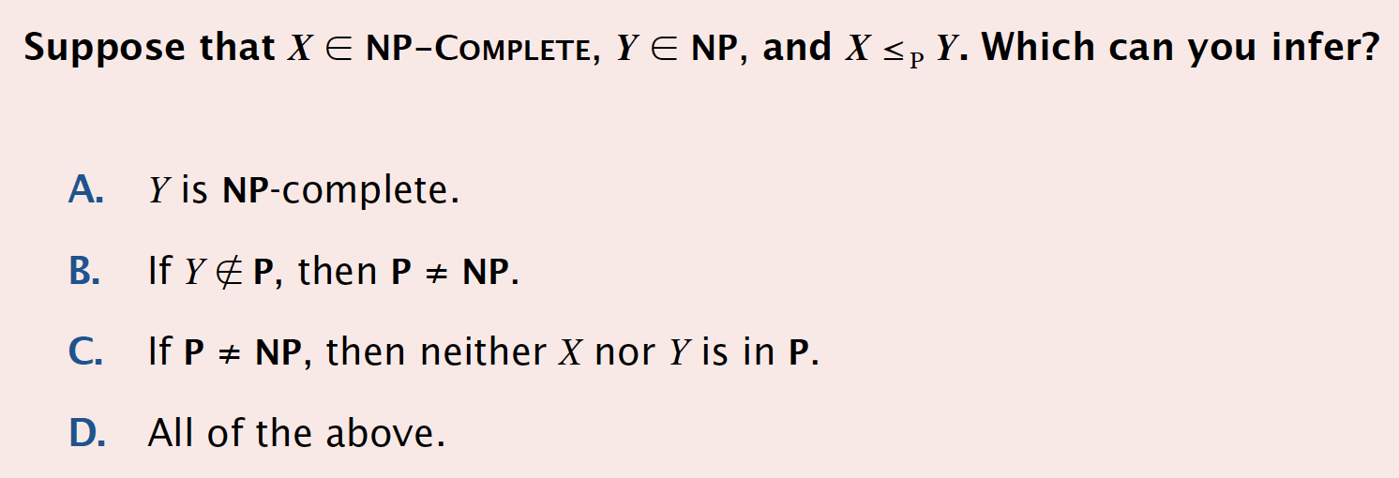
Theorem. If any NP-complete problem is polynomial-time solvable, then P = NP.
Pf. Suppose that L ∈ P and also that L ∈ NPC. For any L′ ∈ NP, we have L′ ≤_{P} L by property 2 of the definition of NP-completeness. Thus, by above Lemma , we also have that L′ ∈ P, which proves the theorem.

Slide 25
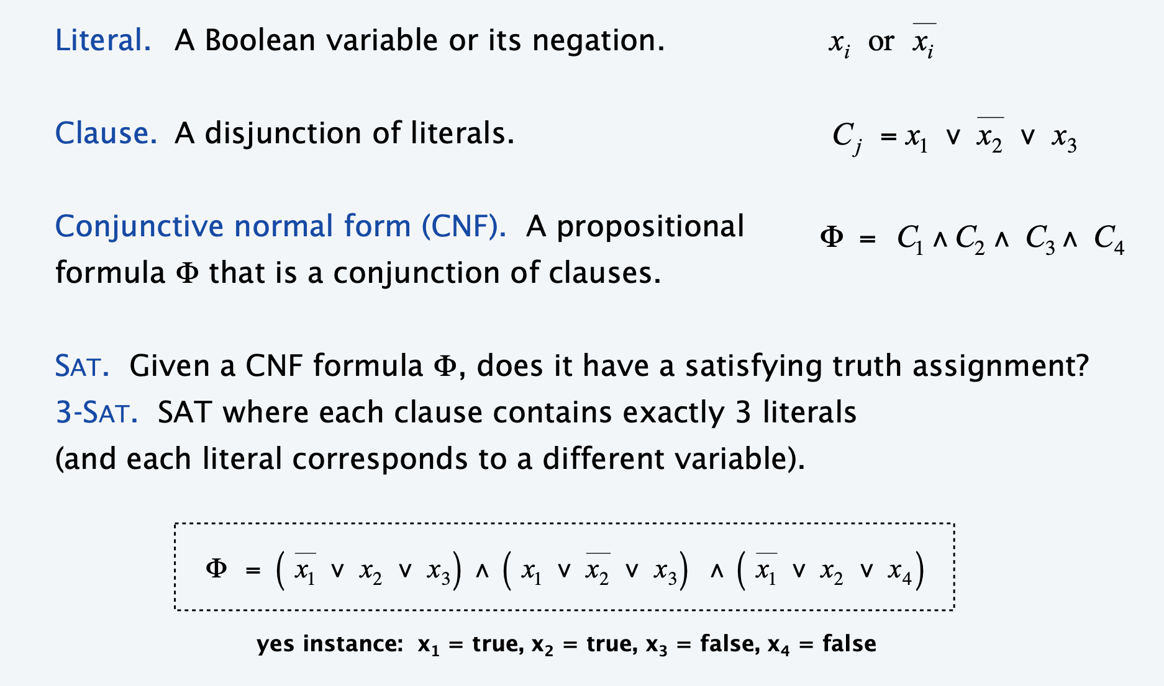
Satisfiability

Slide 26
Circuit Satisfiability
CIRCUIT-SAT. Given a combinational circuit built out of AND, OR, and NOT gates, is there a way to set the circuit inputs so that the output is 1?
Output
Yes: 101
1
0
?
?
?

Slide 27
The "First" NP-Complete Problem
Circuit-SAT:
given a boolean combinatorial circuit composed of AND, OR, and NOT gates, is it satisfiable?
Theorem. CIRCUIT-SAT is NP-complete. [Cook 1971, Levin 1973]
Pf.
The circuit-satisfiability problem belongs to the class NP.
show that every language in NP is polynomial-time reducible to CIRCUIT-SAT.

Slide 28
Establishing NP-Completeness
Method for showing that a problem Y is NP-complete
Show that Y is in NP.
Choose an NP-complete problem X.
X ≤_{P} Y
Justification. If X is a problem such that
Y ≤_{P} X for some Y ∈ NPC, then X is NP-hard. Moreover, if X ∈ NP, then L ∈ NPC.

Slide 29
3-CNF satisfiability
A boolean formula is in conjunctive normal form, or CNF, if it is expressed as an AND of clauses, each of which is the OR of one or more literals.
3-CNF, if each clause has exactly three distinct literals.
Example:
(x₁ ∨ ¬x₁ ∨ ¬x₂) ∧ (x₃ ∨ x₂ ∨ x₄) ∧ (¬x₁ ∨ ¬x₃ ∨ ¬x₄)

Slide 30
The clique problem
A clique in an undirected graph G = (V, E) is a subset V' ⊆ V of vertices, each pair of which is connected by an edge in E.
In other words, a clique is a complete subgraph of G. The size of a clique is the number of vertices it contains.
The clique problem is the optimization problem of finding a clique of maximum size in a graph.
As a decision problem, we ask simply whether a clique of a given size k exists in the graph. The formal definition is
CLIQUE = {〈G, k〉 : G is a graph with a clique of size k}.

Slide 31
Clique problem
Theorem. The clique problem is NP-complete.
Pf. CLIQUE is in NP,
for a given graph G = (V, E), we use the set V' ⊆ V of vertices in the clique as a certificate for G. Checking whether V' is a clique can be accomplished in polynomial time by checking whether, for each pair u, v ∈ V', the edge (u, v) belongs to E.
next prove that 3-CNF-SAT ≤_{P} CLIQUE
reduction algorithm:
Let φ = C₁ ∧ C₂ ∧ ··· ∧ C_{k} be a boolean formula in 3-CNF with k clauses.
We shall construct a graph G such that φ is satisfiable if and only if G has a clique of size k.

Slide 32
Construct of graph G
The graph G = (V, E) is constructed as follows.
For each clause C_{r}=(r1, r2, r3), we place a triple of vertices v^{r1}, v^{r2}, v^{r3} in V.
We put an edge between two vertices v^{ri}, v^{sj} if both of the following hold:
v^{ri} and v^{sj} are in different triples, that is, r ≠ s,
their corresponding literals are consistent, that is ri is not the negation of sj.
This graph can easily be computed from φ in polynomial time

Slide 33
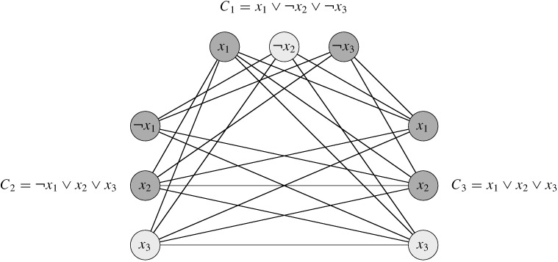
Example
φ = (x₁ ∨ ¬x₂ ∨ ¬x₃) ∧ (¬x₁ ∨ x₂ ∨ x₃) ∧ (x₁ ∨ x₂ ∨ x₃),

Slide 34
Proof. Con.
We must show that this transformation of φ into G is a reduction
First, suppose that φ has a satisfying assignment. Then each clause Cr contains at least one literal rj that is assigned 1. and each such literal corresponds to a vertex v^{rj}. Picking one such "true" literal from each clause yields a set V' of k vertices. We claim that V' is a clique.
For any two vertices v^{ri}, v^{sj} where r ≠ s, both corresponding literals ri rand sj are mapped to 1 by the given satisfying assignment, and thus the literals cannot be complements.

Slide 35
Proof. Con.
Conversely, suppose that G has a clique V' of size k.
No edges in G connect vertices in the same triple, and so V' contains exactly one vertex per triple.
We can assign 1 to each literal ri such that v^{rj} ∈V' , then assigning 1 to both a literal and its complement can not happen, since G contains no edges between inconsistent literals.
Each clause is satisfied, and so φ is satisfied
Any variables that do not correspond to a vertex in the clique may be set arbitrarily

Slide 36
NP-Completeness
〖Example〗 Suppose that we already know that the clique problem is NP-complete. Prove that the vertex cover problem is NP-complete as well.
❖ Clique problem: Given an undirected graph G = (V, E) and an integer K, does G contain a complete subgraph (clique) of (at least) K vertices?
CLIQUE = { <G, K> : G is a graph with a clique of size K }.
❖ Vertex cover problem: Given an undirected graph G = (V, E) and an integer K, does G contain a subset V' ⊆ V such that |V'| is (at most) K and every edge in G has a vertex in V' (vertex cover)?
VERTEX-COVER = { <G, K> : G has a vertex cover of size K }.
Proof: ① VERTEX-COVER ∈ NP
Given any x = <G, K>, take V' ⊆ V as the certificate y.
Reduction algorithm: check if |V'| = K; check if for each edge (u, v) ∈ E, that u ∈ V' or v ∈ V'.
O( N³ )

Slide 37
NP-Completeness
Proof (con.): ② CLIQUE ≤_{P} VERTEX-COVER
G has a clique of size K iff
has a vertex cover of size |V| − K.
⇒ G has a clique V' ⊆ V of size K
O(N²)
Let (u, v) be any edge in
At least one of u or v does not belong to V'
At least one of u or v does belong to V-V'
Every edge of
is covered by a vertex in V-V'
Hence, the set V-V', which has size |V| − K forms
a vertex cover for
⇐ has a vertex cover V' ⊆ V of size |V| − K
For all u, v ∈ V, if (u, v) ∉E , then u ∈V' or v ∈ V' or both.
For all u, v ∈ V, if u ∉V' AND v ∉ V', then (u, v) ∈ E.
V-V' is a clique and it has size |V|−|V'| = K.

Slide 38
Reference:
Introduction to Algorithms, 3rd Edition: Ch.34, p. 1048 - 1105； Thomas H. Cormen, Charles E. Leiserson, Ronald L. Rivest and Clifford Stein. The MIT Press. 2009
Computational complexity: A modern approach
Author(s): Sanjeev Arora, Boaz Barak
Publisher: Cambridge University Press, Year: 2009

Slide 39
NP-Completeness
NP-Completeness
 Recall:
❖ Euler circuit problem: Find a path that touches every edge exactly once.
☺
❖ Hamilton cycle problem: Find a single cycle that contains every vertex.
☹
❖ Single-source unweighted shortest-path problem
☺
❖ Single-source unweighted longest-path problem
☹
☹ No known algorithms are guaranteed to run in polynomial time.

Slide 40

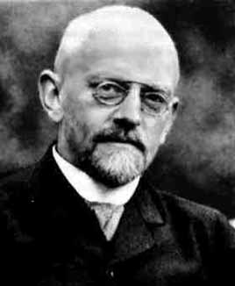
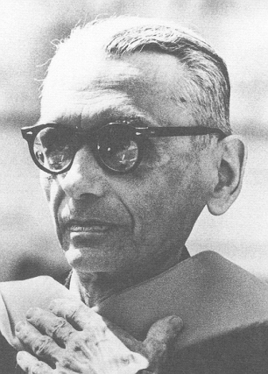
NP-Completeness
☞ Easy vs. Hard
The easiest: O( N ) – since we have to read inputs at least once.
The hardest:
– undecidable problems.
The great mathematician David Hilbert at the 1900 International Congress of Mathematicians outlined 23 research problems to be investigated in the coming century. One of the problems is the question of Decidability — Could there exist, at least in principle, any definite method or process by which all mathematical questions could be decided?
Kurt Gödel proved in 1931 that not all true statements that evolve from an axiomatic system can be proven – we can never know everything nor prove everything we discover.

Slide 41
NP-Completeness
【Example】Halting problem: Is it possible to have your C compiler detect all infinite loops?
Answer:
No.
Proof: If there exists an infinite loop-checking program, then surely it could be used to check itself.
Loop( P )
{
/* 1 */ if ( P(P) loops ) print (YES);
/* 2 */ else infinite_loop();
}
Impossible to tell
What will happen to Loop( Loop ) ?
➢ Terminates
/* 2 */ is true
Loops
➢ Loops
/* 1 */ is true
Terminates

Slide 42
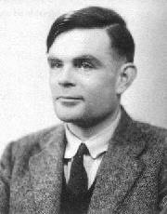
NP-Completeness
☞ The Class NP
TURING MACHINE
Alan Mathison Turing (June 21, 1912 – June 7, 1954)
Founder of Computer Science.
More details can be found at http:\\www.turing.org.uk .
Task
To simulate any kind of computation which a mathematician can do by some arithmetical
method (assuming that the mathematician has infinite time, energy, paper and pen, and is completely dedicated to the work).

Slide 43
NP-Completeness
☞ The Class NP
TURING MACHINE
Components
Infinite Memory
Scanner
and
Operations
One head can point to
one and only one unit at each state,
and it may move at most one unit
to the left or right.
Infinite 1-dimensional
tape(s) divided into units.
DATA storage
① Change the finite control state.
Finite state controller:
control head movements according to
current state and the symbol that
head is pointing to.
INSTRUCTION storage
② Erase the symbol in the unit currently pointed by head, and write a new symbol in.
Scanner
...
③ Head moves one unit to the left (L), or to the right (R), or stays at its current position (S).
... ...
... ... ... ...
...
... ... ... ...

Slide 44
NP-Completeness
A Deterministic Turing Machine executes one instruction at each point in time. Then depending on the instruction, it goes to the next unique instruction.
A Nondeterministic Turing Machine is free to choose its next step from a finite set. And if one of these steps leads to a solution, it will always choose the correct one.
NP: Nondeterministic polynomial-time
The problem is NP if we can prove any solution is true in polynomial time.
Undecidable problems are still undecidable.
〖Example〗Hamilton cycle problem: Find a single cycle that contains every vertex – does this simple circuit include all the vertices?
NP
Note: Not all decidable problems are in NP. For example, consider the problem of determining whether a graph does not have a Hamiltonian cycle.

Slide 45
NP-Completeness

⬧
☞ NP-Complete Problems
-- the hardest
An NP-complete problem has the property that any problem in NP can be polynomially reduced to it.
If we can solve any NP-complete problem in polynomial time, then we will be able to solve, in polynomial time, all the problems in NP!
Given any instance α ∈ Problem A, if we can find a program R(α) → β ∈ Problem B with T_{R}(N) = O(N^{k1}), and another program D(β) to get an answer in time O(N^{k2}). And more, if the answer for β is the same as the answer for α. Then
Decision problem is easier
O(N^{k1})
O(N^{k2})
∀ α ∈ A
β = R(α)
D(β)
answer for β
= answer for α
O(N^{k})
Notes:
Decision problem is easier, since we only have to answer yes or no.
Optimization problem can be related to a decision problem.
Example: SHORTEST-PATH relates to PATH: given a directed graph G, vertices u and v, and an integer k, does a path exist from u to v consisting of at most k edges?

Slide 46
NP-Completeness
〖Example〗 Suppose that we already know that the Hamiltonian cycle problem is NP-complete. Prove that the traveling salesman problem is NP-complete as well.
❖ Hamiltonian cycle problem: Given a graph G=(V, E), is there a simple cycle that visits all vertices?
❖ Traveling salesman problem: Given a complete graph G=(V, E), with edge costs, and an integer K, is there a simple cycle that visits all vertices and has total cost ≤ K?
Proof: TSP is obviously in NP, as its answer can be verified polynomially.
V₁
K = |V|
1
1
2
G has a Hamilton cycle iff G’ has a traveling salesman tour of total weight |V|.
V₂
1
V₃
2
2
1
2
1
✓
V₄
1
V₅
Notes:
Any problem A can be reduced to HCP, then reduced to TSP.

Slide 47
NP-Completeness
The first problem that was proven to be NP-complete was the Satisfiability problem (Circuit-SAT): Input a boolean expression and ask if it has an assignment to the variables that gives the expression a value of 1.
Cook showed in 1971 that all the problems in NP could be polynomially transformed to Satisfiability. He proved it by solving this problem on a nondeterministic Turing machine in polynomial time.

Slide 48
NP-Completeness
A Formal-language Framework
☞ Abstract Problem
an abstract problem Q is a binary relation on a set I of problem instances and a set S of problem solutions.
〖Example〗For SHORTEST-PATH problem
I = { <G, u, v>: G=(V, E) is an undirected graph; u, v ∈ V };
S = { <u, w₁, w₂, …, w_{k}, v>: <u, w₁>, …, <w_{k}, v> ∈ E }.
For every i ∈I, SHORTEST-PATH(i) = s ∈ S.
For decision problem PATH:
I = { <G, u, v, k>: G=(V, E) is an undirected graph; u, v ∈ V;
k ≥ 0 is an integer };
S = { 0, 1 }.
For every i ∈I, PATH(i) = 1 or 0.
☞ Encodings
Map I into a binary string { 0, 1 }* → Q is a concrete problem.

Slide 49
NP-Completeness
☞ Formal-language Theory
— for decision problem
{ 0, 1 }
An alphabet Σ is a finite set of symbols
A language L over Σ is any set of strings made up of symbols from Σ
Denote empty string by ε
Denote empty language by Ø
Language of all strings over Σ is denoted by Σ*
The complement of L is denoted by Σ*-L
The concatenation of two languages L₁ and L₂ is the language
L = { x₁x₂ : x₁ ∈ L₁ and x₂ ∈ L₂ }.
The closure or Kleene star of a language L is the language
L*= {ε} ∪ L ∪ L² ∪ L³ ∪ ···,
where L^{k} is the language obtained by concatenating L to itself k times
L = { x ∈ Σ*: Q(x) = 1 }

Slide 50
NP-Completeness
Algorithm A accepts a string x ∈ {0, 1}* if A(x) = 1
Algorithm A rejects a string x if A(x) = 0
A language L is decided by an algorithm A if every binary string in L is accepted by A and every binary string not in L is rejected by A
To accept a language, an algorithm need only worry about strings in L, but to decide a language, it must correctly accept or reject every string in {0, 1}*
P = { L ⊆ {0, 1}* : there exists an algorithm A that decides
L in polynomial time }

Slide 51
NP-Completeness
A verification algorithm is a two-argument algorithm A, where one argument is an ordinary input string x and the other is a binary string y called a certificate.
A two-argument algorithm A verifies an input string x if there exists a certificate y such that A(x, y) = 1.
The language verified by a verification algorithm A is L = { x ∈ {0, 1}* : there exists y ∈ {0, 1}* such that A(x, y) = 1}.
〖Example〗 For SAT
Certificate:
A language L belongs to NP iff there exist a two-input polynomial-time algorithm A and a constant c such that L = { x ∈ {0, 1}* : there exists a certificate y with |y| = O(|x|^{c}) such that A(x, y) = 1 }. We say that algorithm A verifies language L in polynomial time.

Slide 52
NP-Completeness
⬧
complexity class co-NP = the set of languages L such that
Four possibilities:
P=NP=co-NP
co-NP
P=NP∩co-NP
NP
NP=co-NP
co-NP
NP∩co-NP
NP
P
P
Notes:
An example of an NP-complete problem is the subset sum problem: given a finite set of integers, is there a non-empty subset that sums to zero? To give a proof of a "yes" instance, one must specify a non-empty subset that does sum to zero, which is easy to verify. The complementary problem asks: "given a finite set of integers, does every non-empty subset have a non-zero sum?". Even if someone claims to know the answer to the complementary question for a given set, we do not know how to verify their solution efficiently. To give a proof of the "yes" instance, they may try to list every single subset and their supposedly non-zero sum. However, verifying their claim is just as inefficient as checking all possible sums in the first place. Because of this dilemma, we do not know if the subset sum problem is in co-NP. Note however that the complementary question itself is in co-NP, since the original question is in NP.

Slide 53
NP-Completeness
no harder than
A language L₁ is polynomial-time reducible to a language L₂ ( L₁ ≤_{P} L₂ ) if there exists a polynomial-time computable function f : {0, 1}* → {0,1}* such that for all x {0, 1}*, x ∈ L₁ iff f (x) ∈ L₂.
We call the function f the reduction function, and a polynomial-time algorithm F that computes f is called a reduction algorithm.
A language L ⊆ {0, 1}* is NP-complete if
1. L ∈ NP, and
2. L’ ≤_{P} L for every L’ ∈ NP.

Slide 54
NP-Completeness
〖Example〗 Suppose that we already know that the clique problem is NP-complete. Prove that the vertex cover problem is NP-complete as well.
❖ Clique problem: Given an undirected graph G = (V, E) and an integer K, does G contain a complete subgraph (clique) of (at least) K vertices?
CLIQUE = { <G, K> : G is a graph with a clique of size K }.
❖ Vertex cover problem: Given an undirected graph G = (V, E) and an integer K, does G contain a subset V' ⊆ V such that |V'| is (at most) K and every edge in G has a vertex in V' (vertex cover)?
VERTEX-COVER = { <G, K> : G has a vertex cover of size K }.
Proof: ① VERTEX-COVER ∈ NP
Given any x = <G, K>, take V' ⊆ V as the certificate y.
Reduction algorithm: check if |V'| = K; check if for each edge (u, v) ∈ E, that u ∈ V' or v ∈ V'.
O( N³ )

Slide 55
NP-Completeness
Proof (con.): ② CLIQUE ≤_{P} VERTEX-COVER
G has a clique of size K iff
has a vertex cover of size |V| − K.
⇒ G has a clique V' ⊆ V of size K
O(N²)
Let (u, v) be any edge in
At least one of u or v does not belong to V'
At least one of u or v does belong to V-V'
Every edge of
is covered by a vertex in V-V'
Hence, the set V-V', which has size |V| − K forms
a vertex cover for
⇐ has a vertex cover V' ⊆ V of size |V| − K
For all u, v ∈ V, if (u, v) ∉E , then u ∈V' or v ∈ V' or both.
For all u, v ∈ V, if u ∉V' AND v ∉ V', then (u, v) ∈ E.
V-V' is a clique and it has size |V|−|V'| = K.

